Slide 1
Ink and Gesture recognition techniques

Slide 2
Definitions
Gesture – some type of body movement
  a hand movement
  Head movement, lips, eyes
Depending on the capture this could be
  Digital ink
  Accelerometer data
  Actual body movement detected by vision analysis (ie what the vision group do)
With digital ink
  Stroke – time series of x,y points may include pressure and pen tilt data
  Sometime people use the term ‘gesture’ to mean an editing stroke – delete, cut, copy etc

Slide 3
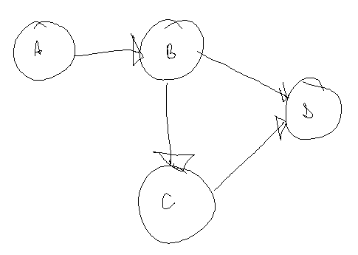
Dissecting a diagram
Components
  Nodes
    Contain label
  Arc/edge
    Line and arrow
Semantic meaning
  Actions
  Connections
  Directed flow

Slide 4
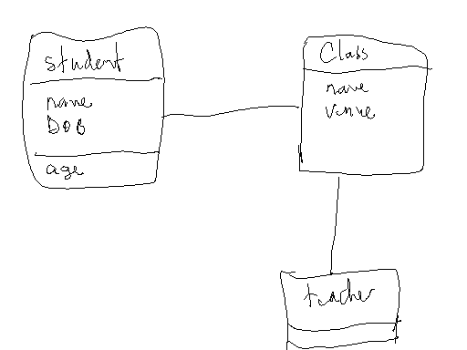
What are the components here?
What is the semantic meaning?

Slide 5
Recognition Problems
Accuracy
Flexibility
  Past diagramming tools are limited to shapes or specific styles of drawing components
  Modeless interaction

Slide 6
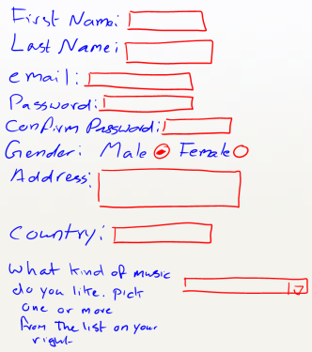
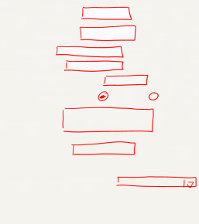
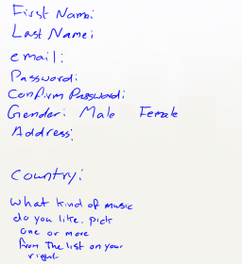
Where to start?
Step 1 is dividing writing and drawing because there is a fundamental semantic difference
Text-Shape Divider
Shape Recogniser
Text Recogniser

Slide 7
Our approach to diagram recognition
Separate Writing and Drawing (divider)
Recognize individual strokes
Join strokes into basic shapes
Join basic shapes to make components
Apply semantics to understand diagrams

Slide 8
Feature-based recognition
Recognizer
Features
Algorithm

Slide 9

RATA Generated Recognizers
RATA
1. Describe Vocabulary
2. Collect Examples
3. Label Examples
5. Generate Model
4. Compute Features
Application Program
RATA (Recognizer Algorithms and Training Attributes)

Slide 10
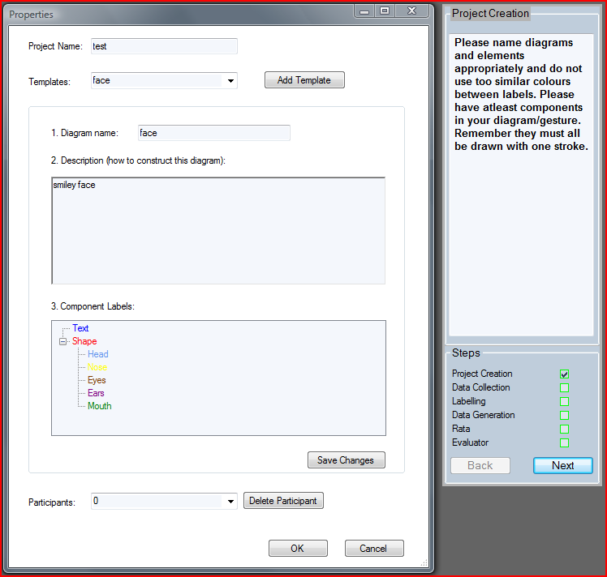
1. Describe Vocabulary

Slide 11
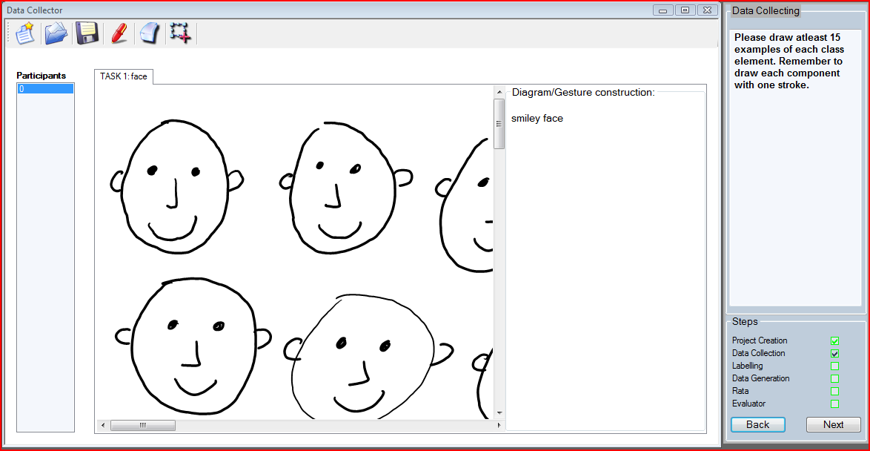
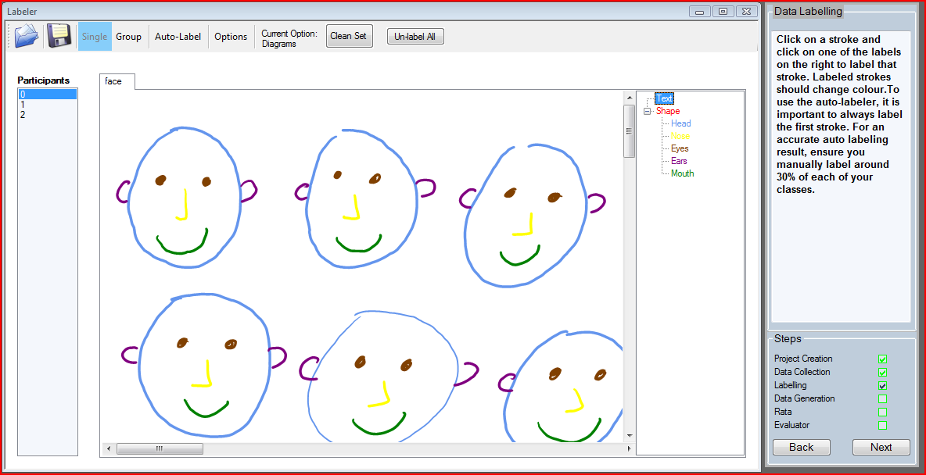
2&3)Collect and Label Data
About 15 examples of each class (type to be recognized)

Slide 12
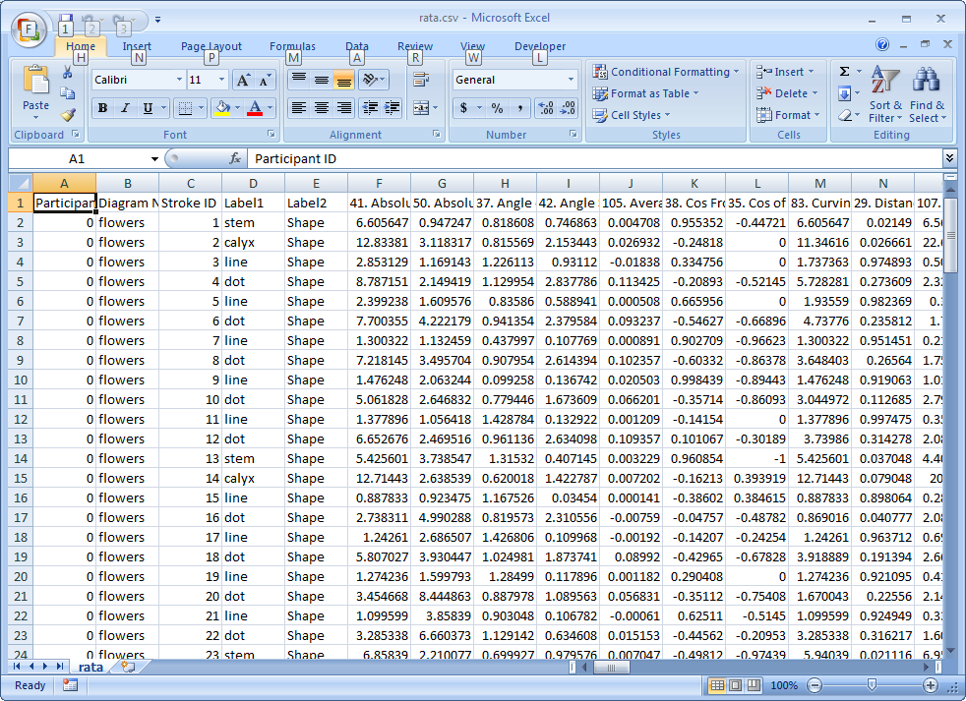
4. Compute Features
For each stroke we calculate up to 114 features of each ink stroke
Feature Category | Example
1. Curvature | Total angle traversed by the stroke
2. Density | Amount of ink inside stroke bounding box
3. Direction | Maximum change in direction
4. Divider Results | Text shape divider result
5. Intersections | # Self intersections
6. Pressure | Maximum pressure
7. Size | Bounding box length
8. Spatial context | Distance to the closest stroke
9. Temporal context | Distance to the next stroke
10. Time / speed | Total duration of the stroke

Slide 13
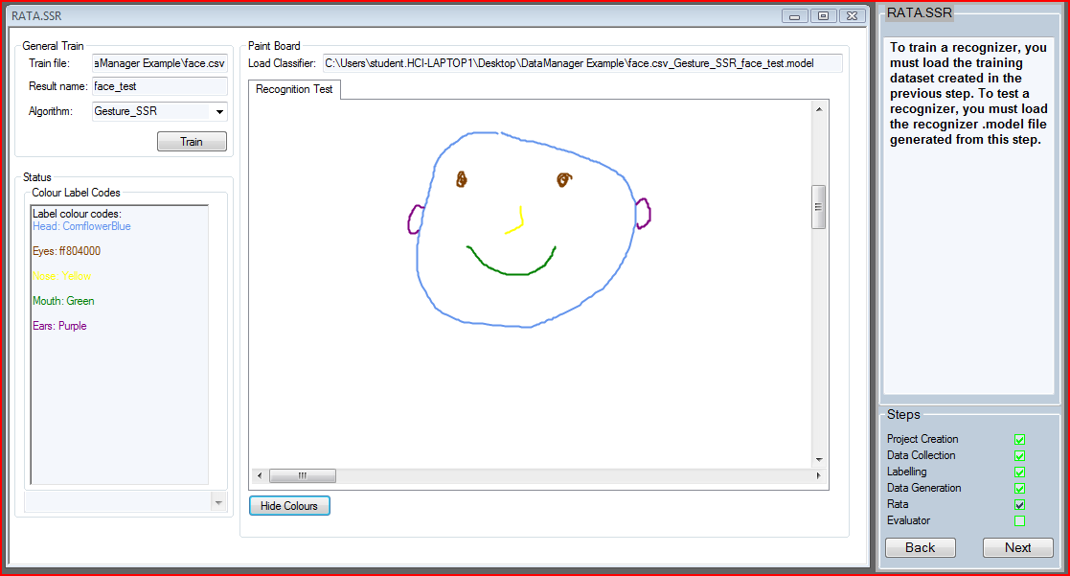
5. Generate Model
Via RATA interface to Weka

Slide 14
Using the recognizer component
Load it
inkPanelClassifier = ClassifierCreator.GetClassifier ( "C:\\Users....rata.model");
Pass ink strokes
  string result = inkPanelClassifier.classifierClassify( myDrawingInk.Ink.Strokes, myDrawingInk.Stroke[i]);
  if (result.Equals(“mouth"))
  myDrawingInk.Stroke[i].Color.Green;
  else .....

Slide 15
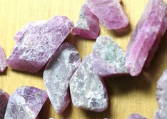
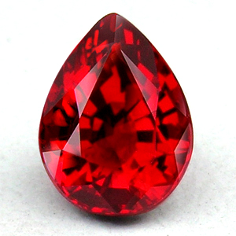
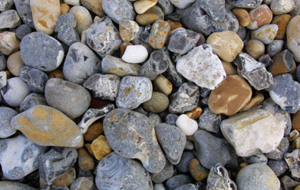
Algorithm selection
Many algorithms in WEKA
  Want good ones for sketch recognition
Select 9 Algorithms
  Looking for accuracy
  Parameter tuning, ensembles, feature selection
Polish

Slide 16
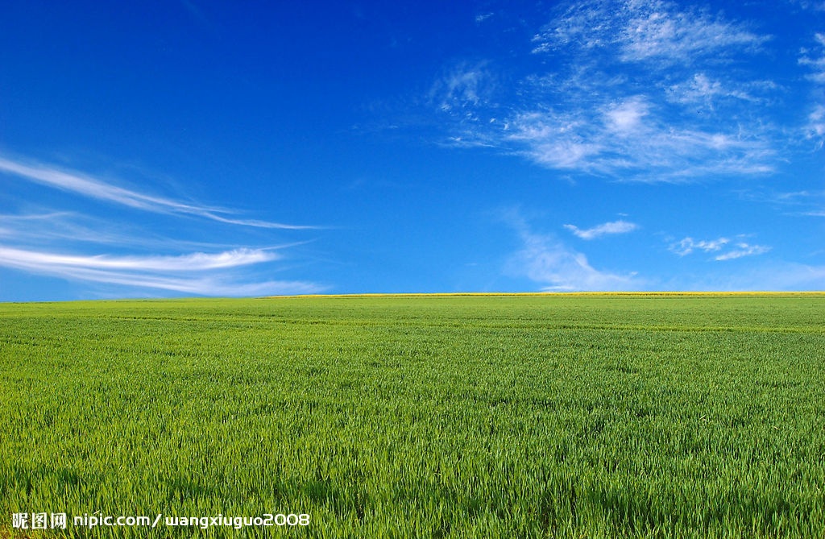
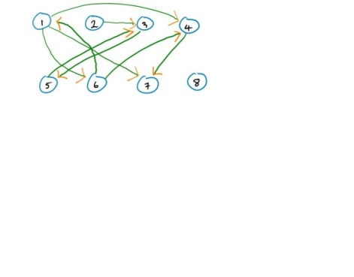

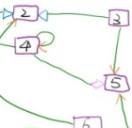

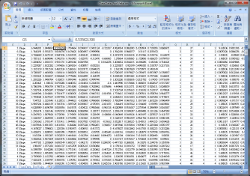

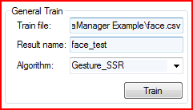

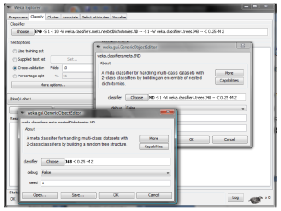
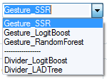
Sample usage
Features
Data mining
Collection, Labeling, Feature generation
Novice: Rata generator
Little time
Feature file
Algorithm
A selection of fast and accurate ones
Wrapper
Expert: WEKA interface
Further tuning
Add algorithm
FAST AND ACCURATE?

Slide 17
Best Weka Algorithms
Algorithm Name | Ranking
Bayes Network | 1st
Random Forest | 2nd
LogitBoost Alternating Decision Tree | 3rd
LogitBoost | 4th
Logistic Model Trees | 5th
Multilayer Perceptron | 6th
Ensembles of Nested Dichotomies | 7th
Sequential Minimal Optimization | 8th
Bagging | 9th
Use the better performing setting
Consider all situations
  10 fold, ordered splitting, random splitting
Very accurate
  Average accuracy:
  98.6 %(BN) ~ 96.4%(Bagging)

Slide 18
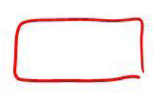

Ensemble
Rectangle
Voting
  Level of confidence
  Equal weighting
Best voting combination – RATA.Gesture
  BN, RF, LB, and LMT (significantly more accurate than best individual algorithm BN)
  Strength through ensemble
  Combine the best individuals may not give the best ensemble
Rectangle: 70%
Oval: 30%
Rectangle: 25%
Oval: 75%
Rectangle: 90%
Oval: 10%
Rectangle: 62%
Oval: 38%
A
B
C
 | BN | RF | LAD | LB | LMT | MLP | END | SMO | BAG
Ranking | 1st | 2nd | 3rd | 4th | 5th | 6th | 7th | 8th | 9th
This is our gem

Slide 19
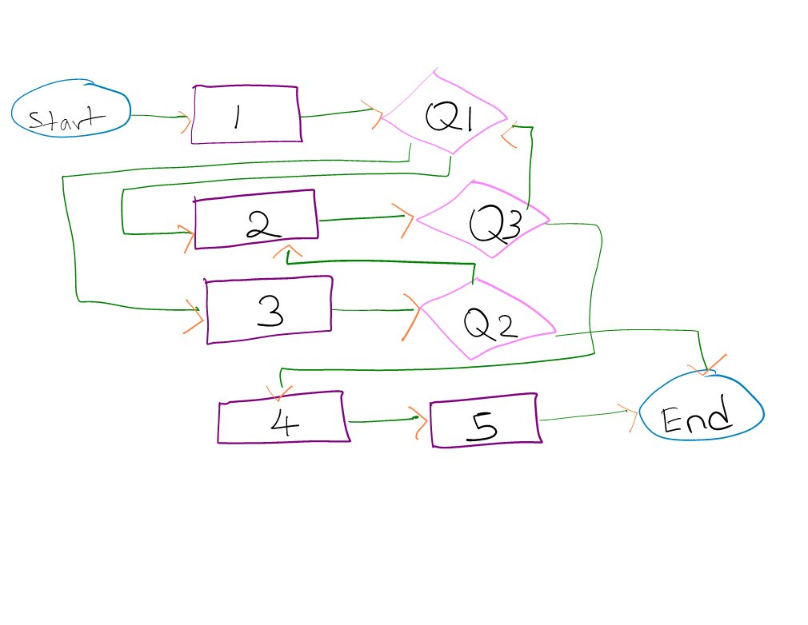
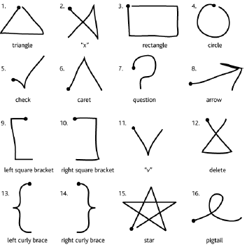
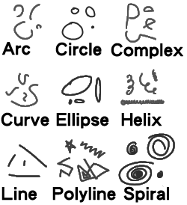
Recognition rates – single stroke shapes/gestures
 | FlowChart | $1 Data |  | PaleoSketch Data |  | Avg
 |  | All | Part | All | Part
Our Recognizers
RATA.Gesture | 99.3 | 96.4 | -- | 92.5 | 96.8 | 97.5
RATA.SSR | 98.7 | 97.1 | -- | 89.9 | 94.9 | 96.9
Other Trainable Recognizers
$1 | 82.8 | 98.3 | -- | 78.9 | 89.8 | 90.3
Rubine | 93.3 | 95.7 | -- | 41.2 | 46.1 | 78.4
CALI | 85.2 | 37.5 | 85.1 | 42.2 | 95.0 | 88.4
PaleoSketch | 92.0 | 50.7 | 71.4 | 95.7 | 98.3 | 87.2
Chang, S. H.-H., R. Blagojevic, B. Plimmer (2012). "RATA.Gesture: A Gesture Recognizer Developed using Data Mining." Artificial Intelligence for Engineering Design, Analysis and Manufacturing (AI EDAM) 26(3): p. 351-366

Slide 20
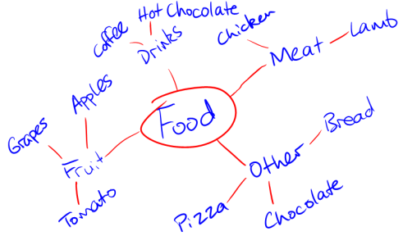
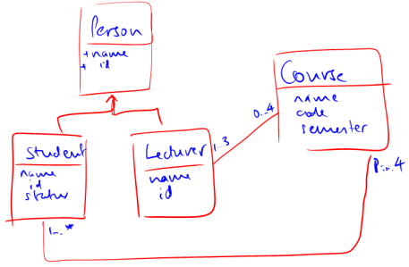
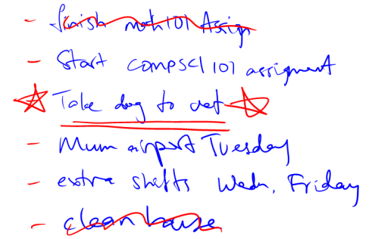
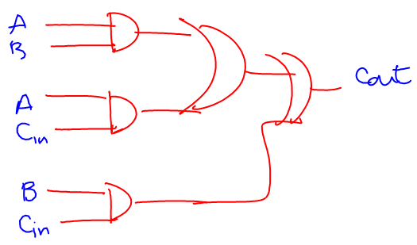
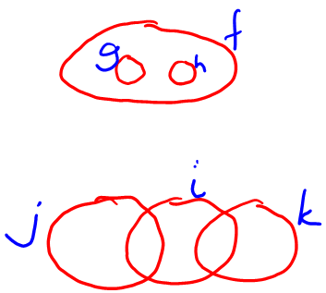
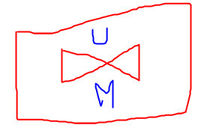
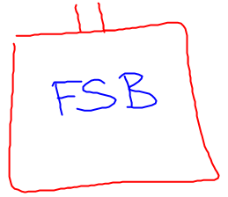
Recognition rates - Divider
Blagojevic R., B. Plimmer, J. Grundy, Y. Wang, Using Data Mining for Digital Ink Recognition: Dividing Text and Shapes in Sketched Diagrams, 2011, Volume 35, Issue 5, Computers & Graphics, p 976–991

Slide 21
Recognition rates - Divider
LogitBoost LADTree 1 LADTree 2 Vote 2 Microsoft Vote 1 Entropy Divider 2007
Dividers
Key:
_____ Mind-maps _____Euler
_____ To-do lists _____COA
_____UML _____ Logic
_____Simple Avg _ _ _ _Weighted Avg
Blagojevic R., B. Plimmer, J. Grundy, Y. Wang, Using Data Mining for Digital Ink Recognition: Dividing Text and Shapes in Sketched Diagrams, 2011, Volume 35, Issue 5, Computers & Graphics, p 976–991

Slide 22
So Far
Divider (Rachel Blagojevic)
Single stroke recognizers (Samuel Chang)
Grouper (Philip Stevens)
Ink Feature Library (Rachel Blagojevic)
Enabling tools – data collection, labeling, dataset generator, recognizer evaluation, weka interface, software component generation

Slide 23
Next
Using divider + SSR + grouper together
Semantics
  Connection
  Containment
  Intersection
THEN - We *might* be able to provide the support expected of a diagramming tool

